Slide 1
Understanding Conformance Testing Using the NIST HL7 v2 eDOS-EHR Validation Tool
Conformance Criterion:
Receive and incorporate laboratory order compendium (eDOS*)
Robert Snelick, NIST (rsnelick@nist.gov)
V1.0 August 2, 2016
*Electronic Directory of Services

Slide 2
Purpose
Provide an additional resource to explain the process of HIT Module conformance testing related to HL7 v2 eDOS-Electronic Health Record (eDOS-EHR) Messaging
Describe NIST approach for assessing and validating the test messages
Provide an overview of the testing requirements

Slide 3
Table of Contents
List of Resources
Scope of Conformance Testing
Incorporate laboratory order compendium criterion and conformance standards
Testing Process Diagram
Testing Workflow Diagrams
Explanation of Test Scenarios and Test Cases/Steps
Example Test Step Documents
Test Tool Overview and Example Test Tool Screen
Additional Resources

Slide 4
Resources
Test Tool Web Site (http://hl7v2-edos-r1-testing.nist.gov/edos-r2/#/home )
Validation Tools
User Documentation
Normative Test Process Document (on Test Tool Documentation Tab)
S&I Framework Laboratory Test Compendium Framework (eDOS) Implementation Guide
(http://www.hl7.org/implement/standards/product_brief.cfm?product_id=151 )
eDOS-EHR Tool Quick Reference Guide (In Process)
eDOS-EHR Tool Tutorial (In Process)
Release Notes for each version of Test Tool
(on Test Tool Documentation Tab)
eDOS Test Tool Google Group for submitting questions to the Test Tool developers (https://groups.google.com/forum/#!forum/hl7v2-lab-compendium-testing)

Slide 5
Scope of Conformance Testing - eDOS-EHR
Testing is directed at a Health IT Module (product), not specific instances (installations) of the Module
The conformance criterion is focused on testing the capability of an HIT Module to receive and incorporate new and update HL7 laboratory order compendium (eDOS) messages created for electronic transmission
Site-specific configuration of the HIT Module is not being tested
Method of transmitting the eDOS messages is not being tested
Testing focus and scope are narrow
Testing encompasses only specific use cases described in the eDOS Implementation Guide (IG)
Testing does not attempt to address the entire spectrum of use cases found in practice
How the eDOS messages are received by/imported into the HIT Module is out of scope
Sending LIS systems are not being tested using the EHR Test Plan in the eDOS Test Tool (sending LIS systems are being tested using the LIS Test Plan in the eDOS Test Tool)
HIT Module conformance testing is driven by the test data
The HIT Module is required to demonstrate the ability to receive HL7 v2 eDOS messages and to incorporate the lab tests; specific test data for the messages are provided in Test Cases
The test data and Test Cases do not cover all possible clinical lab tests; through consultation with clinical laboratory experts, a subset of key lab tests were selected for testing
The format in which the test data are displayed on the screen of the HIT Module is not part of the testing
Clinical laboratory subject matter experts, in collaboration with the National Institute of Standards and Technology (NIST), provided the Test Scenarios, Test Cases, and Test Data for the Laboratory Order Compendium (eDOS) conformance testing

Slide 6
Conformance Criterion - eDOS-EHR
Receive and incorporate laboratory order compendium testing evaluates the capability for an HIT Module to receive and process
New eDOS messages to create a lab order compendium
Update eDOS messages that add-to or modify the existing lab order compendium
According to
HL7 Version 2.5.1 Implementation Guide: S&I Framework Laboratory Test Compendium Framework Release 2, DSTU Release 2 - US Realm, September 2015 (Referred to as the eDOS IG)
LOINC® version 2.50

Slide 7
Conformance Standards - eDOS-EHR
Electronic incorporation and transmission of lab order compendium messages
HL7 Version 2.5.1 Implementation Guide: S&I Framework Laboratory Test Compendium Framework Release 2, DSTU Release 2 - US Realm, September 2015
Vocabulary for representing electronic health information
Logical Observation Identifiers Names and Codes (LOINC®) Database version 2.50, a universal code system for identifying laboratory and clinical observations produced by the Regenstrief Institute, Inc.

Slide 8
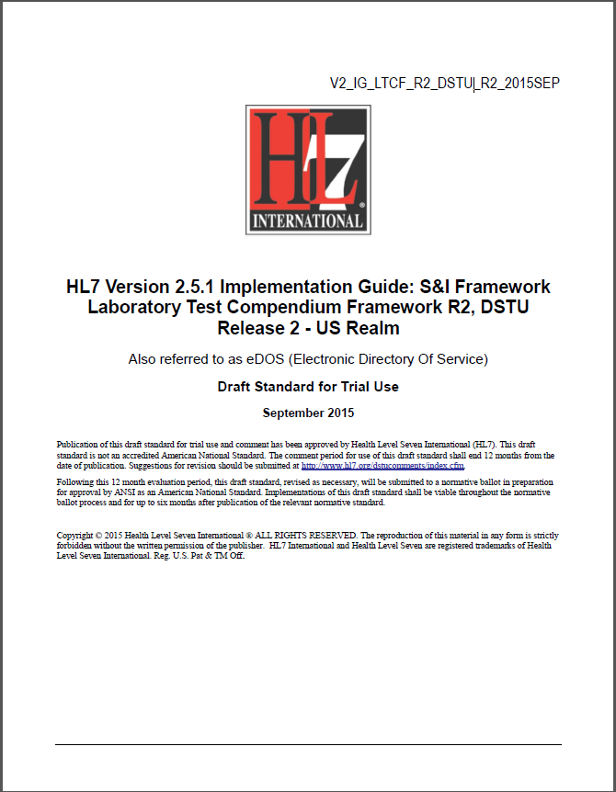
Conformance Standards Document – eDOS-EHR
HL7 v2.5.1 eDOS Implementation Guide, Release 2, DSTU Release 2, Sept 2015
http://www.hl7.org/implement/standards/product_brief.cfm?product_id=151

Slide 9

Vocabulary Standard Web Site – eDOS-EHR
LOINC® Database version 2.50
http://loinc.org/

Slide 10
Receive and Incorporate eDOS Testing Process
HL7 eDOS IG 2015
NIST Validation Tool
HIT Module
(System under Test)
Conformance Test Scope
MFN Message
Configuration of Changeable Data as Needed
MFN Elements
Visual Inspection
Message
Exported/Imported*
Master File Notification (MFN) Message Elements
Juror Document
Diagram does not show testing process for Master File Acknowledgment (MFK) messages
The HIT Module is the system being tested. The Module is required to receive* and process eDOS messages that meet the conformance and vocabulary standards (see previous slides) and to incorporate specific test data contained in the messages.
The messages are exported* from the NIST Test Tool and imported* into the Module, and validation (visual inspection) is performed by the Tester/Inspector using the Test Case-specific Juror Document.
Test data are available through the Test Tool via the Test Steps in the Test Cases.
Each Test Step includes a Test Story that provides the context, a Test Data Specification that lists the data that are typically available in the clinical setting, a Message Content Data Sheet that shows a conformant message (in a table format) including a detailed profile of the required elements, and a Test Message
Each Test Case includes a Juror Document.
*How the message is exported/imported/received is not in-scope for certification testing

Slide 11
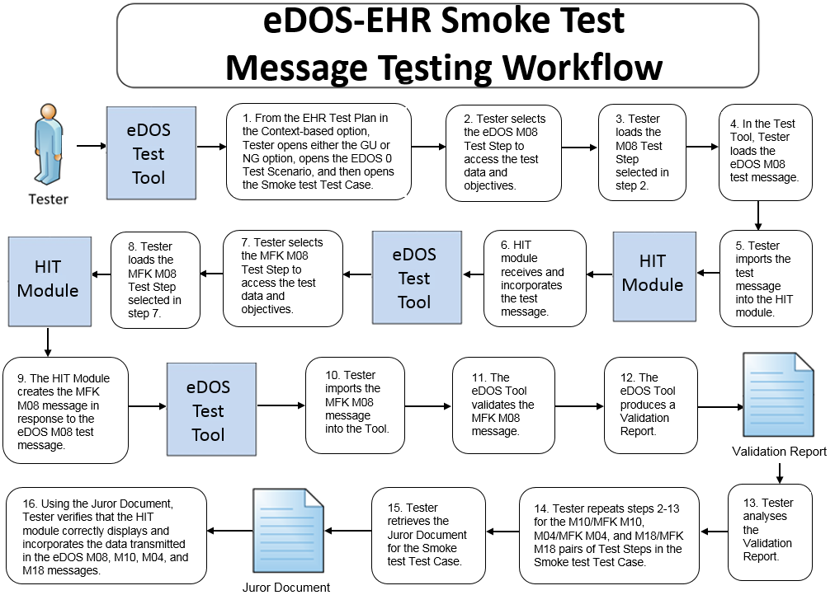
Receive and Incorporate Testing Workflow Diagram
This diagram shows
How the steps of the receive and incorporate Smoke test are sequenced
When the Test Tool is to be used
*Acknowledgement (MFK) messages are tested only in the Smoke Test Scenario

Slide 12
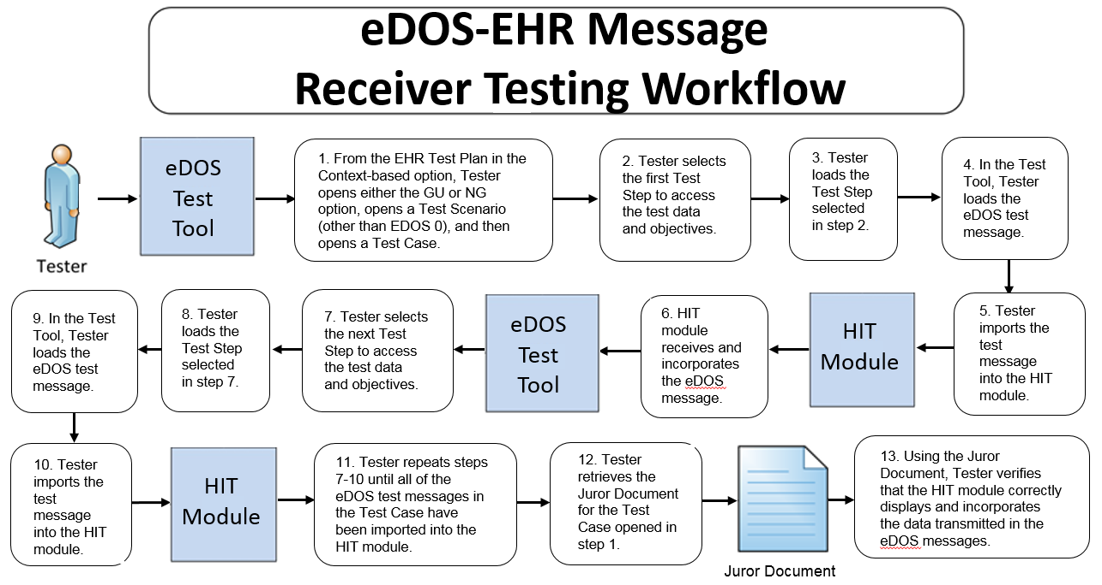
Receive and Incorporate Testing Workflow Diagram
This diagram shows
How the steps of the receive and incorporate* test are sequenced
When the Test Tool is to be used
*Non-Smoke Test

Slide 13
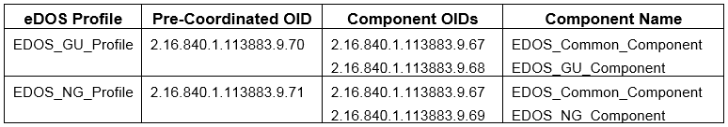
Test Scenarios and Test Cases/Steps
Test data are available in the eDOS Test Tool via the Test Scenarios provided in the EHR Test Plan
The Test Scenarios are composed of Test Cases and Test Steps
Each Test Step includes a Test Story, Test Data Specification, Message Content Data Sheet, Test Message
Each Test Case includes a Juror Document
The HL7 Version 2.5.1 Implementation Guide: S&I Framework Laboratory Test Compendium Framework (eDOS) interoperability standard defines two Profile options relevant for conformance testing
The Tool provides three Test Scenarios for the GU Profile options and three for the NG Profile options
For the purpose of the testing, conformance to only one Profile option is required — the Vendor will inform the Tester as to which Profile option their HIT Module is conformant

Slide 14
Test Scenarios and Test Cases/Steps (cont’d)
The HL7 Version 2.5.1 Implementation Guide: S&I Framework Laboratory Test Compendium Framework (eDOS) interoperability standard defines
Four transaction message types relevant for eDOS conformance testing
MFN^M08^MFN_M08 – Master File Notification Test/Observation (“M08”)
MFN^M10^MFN_M10 – Master File Notification Test/Observation Batteries (“M10”)
MFN^M04^MFN_M04 – Charge Description Master File Message (“M04”)
MFN^M18^MFN_M18 – Test/ Observation (Payer) Master File Message (“M18”)
Four Acknowledgment message types relevant for eDOS conformance testing
MFK^M08^MFK_M01 – Master File Acknowledgement Test/Observation
MFK^M10^MFK_M01 – Master File Acknowledgement Test/Observation Batteries
MFK^M04^MFK_M01 – Master File Acknowledgement Charge Description
MFK^M18^MFK_M01 – Master File Acknowledgement Test/Observation (Payer) Master File Message

Slide 15
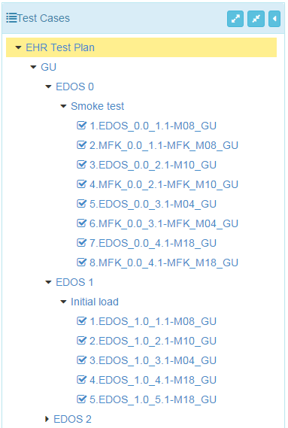
Test Scenarios and Test Cases/Steps (cont’d)
Test Scenarios/Cases/Steps for the two Profile options are provided in the EHR Test Plan in the eDOS Test Tool
This figure shows a sub-set of the Test Scenarios/Cases/Steps in the EHR Test Plan for the GU Profile option
The Tester shall execute all three Test Scenarios for either the GU or NG Profile
Profile option
Test Scenario
Test Case
MFN Test Step
MFK Test Step
Test Scenario
Test Case
MFN Test Step

Slide 16
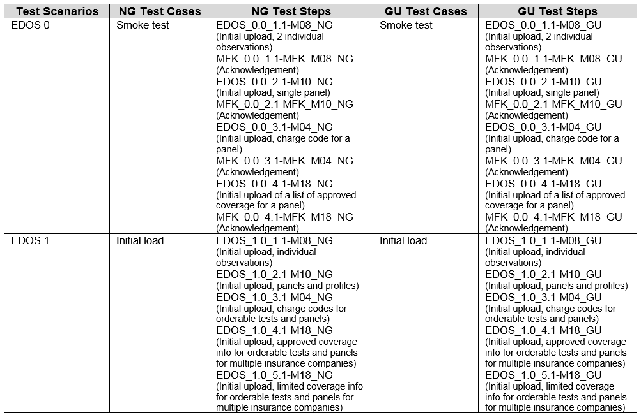
Test Scenarios and Test Cases/Steps (cont’d)
Table below shows Test Cases/Steps for Smoke Test and Initial Load

Slide 17
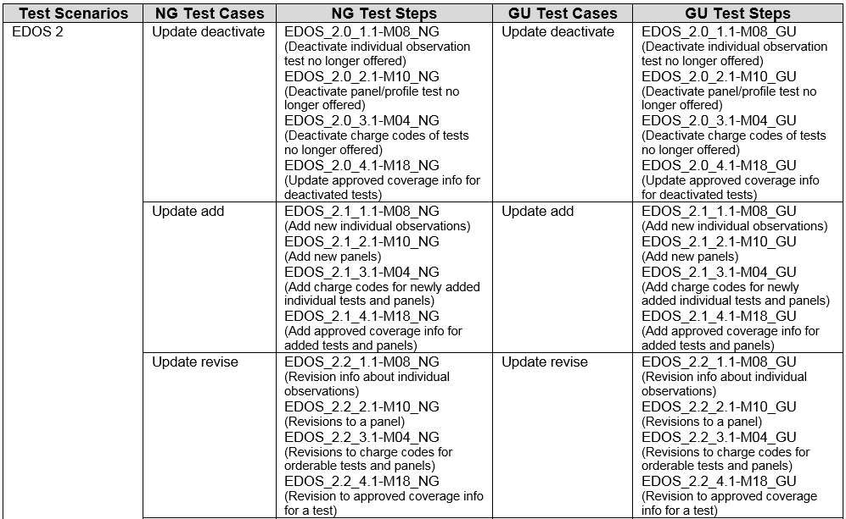
Test Scenarios and Test Cases/Steps (cont’d)
Table below shows first three of the six Update Test Cases in the Tool

Slide 18
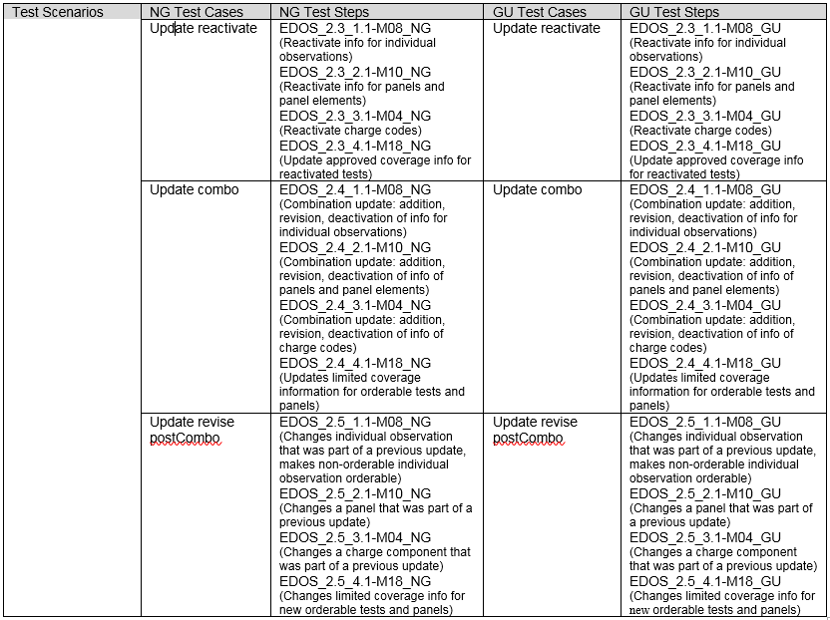
Test Scenarios and Test Cases/Steps (cont’d)
Table below shows last three of the six Update Test Cases in the Tool

Slide 19
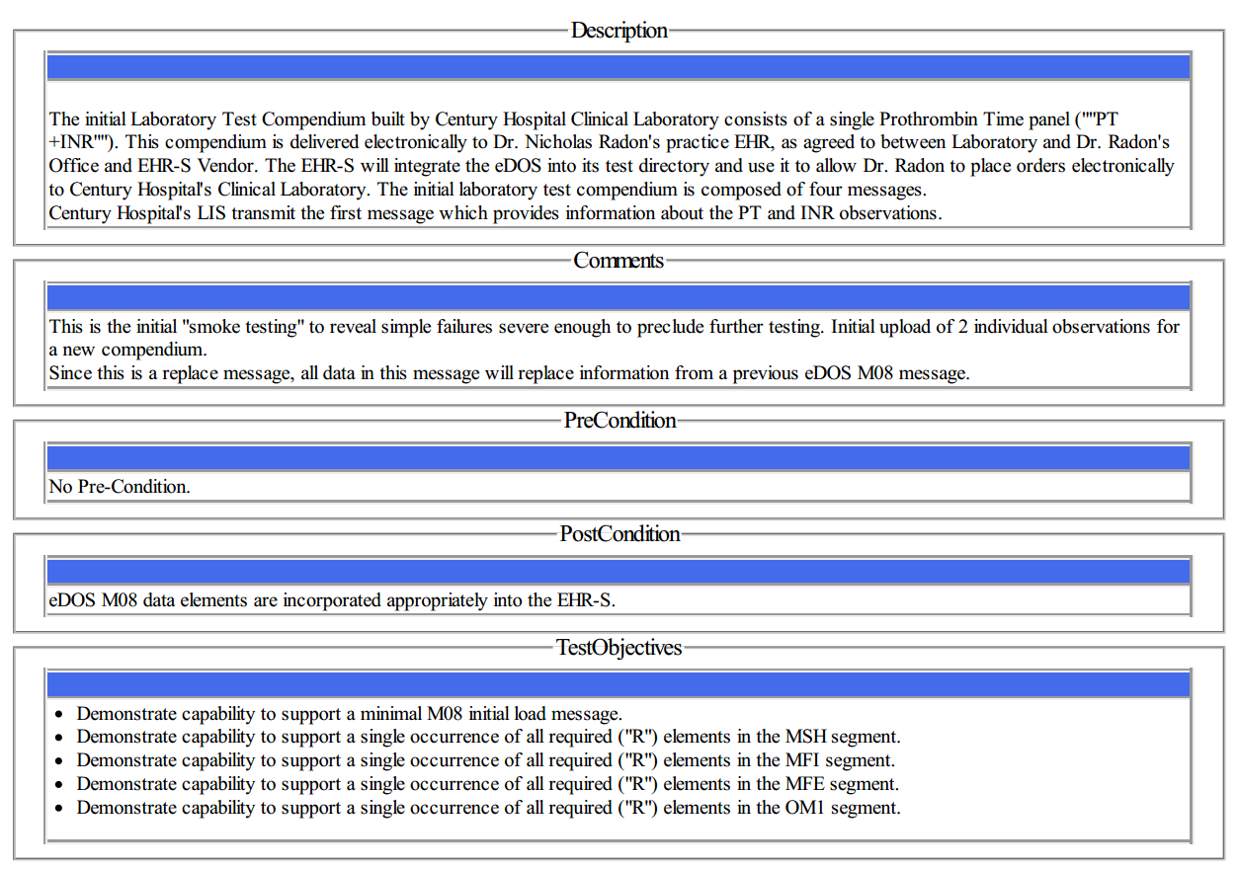
Test Data Documents* for Each Test Step
Test Story
Each Test Step includes a narrative Test Story that describes a real world situation and provides context for the Test Step
Along with the Test Story description is information about PreConditions, PostConditions, Test Objectives, and Notes to Testers
Example: Test Data pdf document for the EDOS_0.0_1.1-M08_GU Test Step for the Smoke Test
*Available for viewing online and via downloaded pdf or txt file

Slide 20
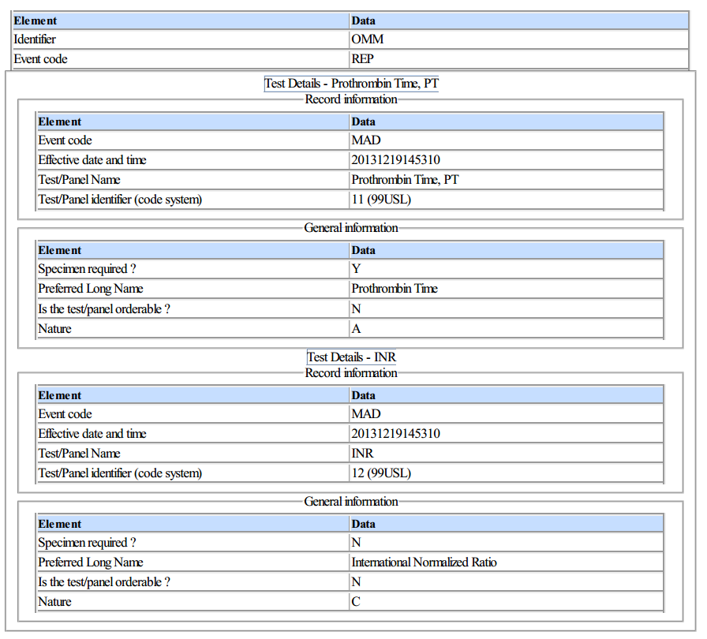
Test Data Documents for Each Test Step (cont’d)
Test Data Specification
Each Test Step includes a Test Data Specification that
Lists data associated with the Test Story
Consists of typical information found in the clinical setting
A test message is generated using these data and the eDOS-EHR Test Tool functions
Example: Test Data pdf document for the EDOS_0.0_1.1-M08_GU Test Step for the Smoke Test
20
Notes:
20

Slide 21
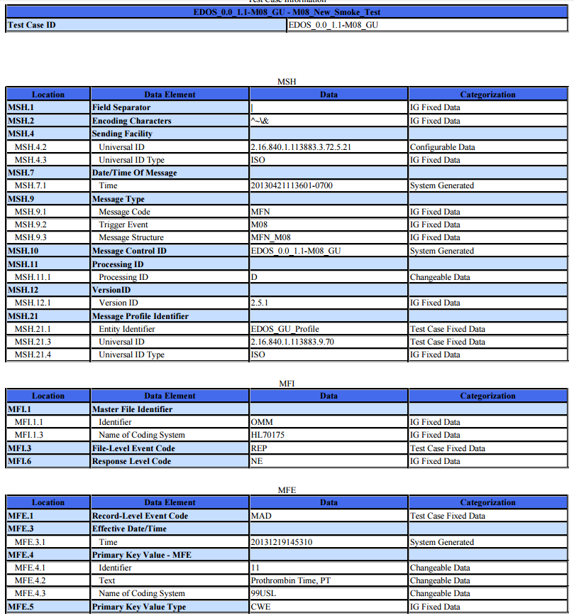
Test Data Documents for Each Test Step (cont’d)
Message Content Data Sheet
Each Test Step includes a Message Content Data Sheet that shows a conformant message instance
The category of the test data is listed in the Categorization column
The Categorization indicates how the data in the messages that are imported into the Tool are assessed by the validation engine
Example: Test Data pdf document for the EDOS_0.0_1.1-M08_GU Test Step for the Smoke Test
21
Notes:
21

Slide 22
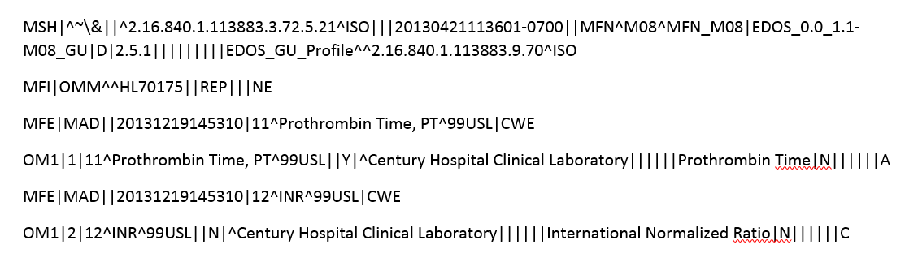
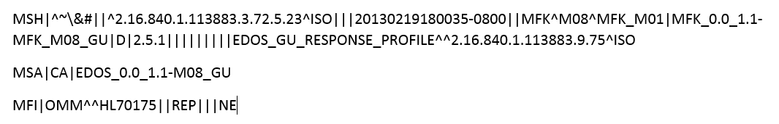
Test Data Documents for Each Test Step (cont’d)
Example Test Message
A test message is provided that coincides with the Test Story for the Test Step
For the EHR Test Plan
The eDOS Master File Notification (MFN) test messages are exported (sent) by the eDOS Test Tool (acting as the LIS or EHR-S lab module) and are imported (received) by the HIT Module being tested
For the Smoke Test only, a Master File Acknowledgement (MFK) message is sent by the HIT Module and received by the eDOS Test Tool in response to each Master File Notification message
Example Test Message for the EDOS_0.0_1.1-M08_GU Test Step for the Smoke Test
Example Test Message for the MFK_0.0_1.1-MFK_M08_GU Test Step for the Smoke Test

Slide 23
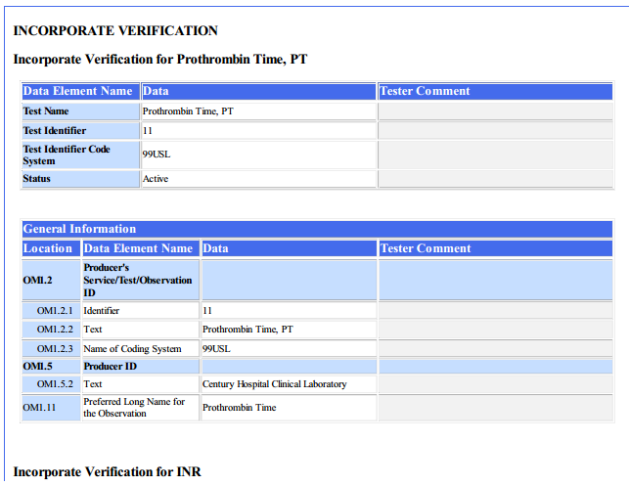
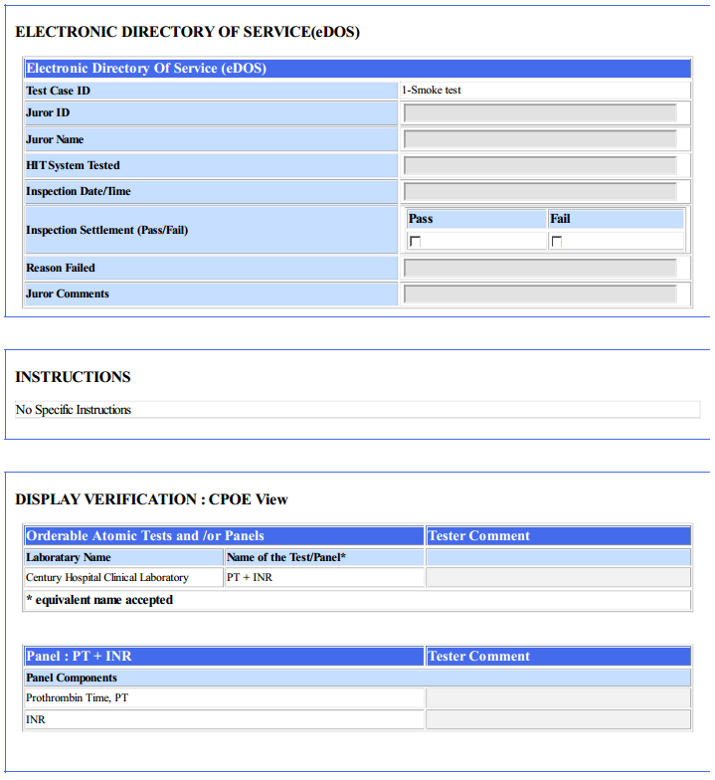
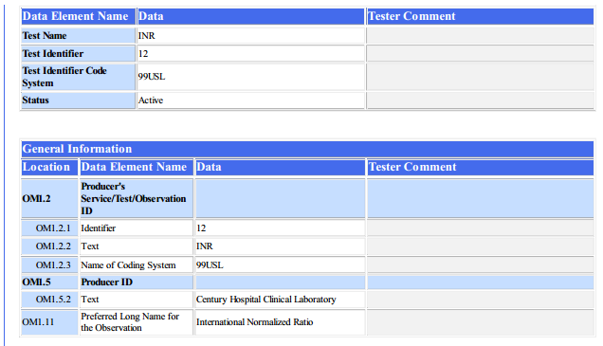
Test Data Documents for Each Test Step (cont’d)
Juror Document
Each Test Case includes a Juror Document, a checklist used by the Tester/Inspector to assess and record whether the eDOS data in the set of Test Messages are incorporated into the HIT Module
Example: Test Data pdf document for the EDOS_0.0_1.1-M08_GU Test Step for the Smoke Test
23
Notes:
23

Slide 24
The Juror Document
Some elements contained in the messages are not subject to display or incorporate verification and are not listed on the Juror Document
Juror Document categorizes test data according to how the data in the HIT Module are to be verified
Document is composed of two sets of tables
“Display Verification” (labeled “Display Verification : CPOE View”, “Display Verification : Specimen Collection / AOE View”, etc.)
Lists the data that are required to be displayed in the Module in accordance with the eDOS Implementation Guide
Used by the Tester to verify and document that the data are viewable in the Module by the user in the specified manner
“Incorporate Verification”
Lists the data that are required to be incorporated into the Module in accordance with the eDOS Implementation Guide
Used by the Tester to verify and document that the data are incorporated into the Module in the specified manner

Slide 25
NIST eDOS-EHR Test Tool Overview
Purpose: The tool generates eDOS messages to be received/incorporated by HIT Modules and is intended to be used for conformance testing according to the standards listed on the Conformance Standards page of this slide set
Tool Key Capabilities
Context-based testing / EHR Test Plan | Used for conformance testing driven by test data Validates HIT Modules that receive and process HL7 messages in accordance with the ONC S&I Framework Laboratory Order Compendium (eDOS) implementation guide (IG) Provides Juror document for inspection testing
Profile Viewer | Provides a browse-able version of the conformance profile that encapsulates the requirements. Profile Viewer tab is accessible in Context-based testing once a Test Case or Test Step is “loaded”. Can be used to assist in the interpretation of message errors.
Value Sets Browser | Provides a browse-able view of the Value Sets and Vocabulary requirements. Value Sets tab is accessible in Context-based testing once a Test Case or Test Step is “loaded”. Can be used to assist in the interpretation of value set errors.
Documentation | Provides access to documents that assist in using the Tool for conformance testing (including the NIST Normative Test Process Documents, Implementation Guides, and Release Notes).
No registration or log-in credentials are required. Simply click on the link below to access and use the Tool
NOTE: The Test Tool (.war file) can also be downloaded and installed locally.
NOTE: Web Application is compatible with Firefox, Chrome, or Safari. Recommended browsers are Firefox and Chrome.
Register to Google Group at: https://groups.google.com/forum/#!forum/hl7v2-lab-compendium-testing to ask questions and provide feedback.
http://hl7v2-edos-r1-testing.nist.gov/edos-r2/#/home

Slide 26
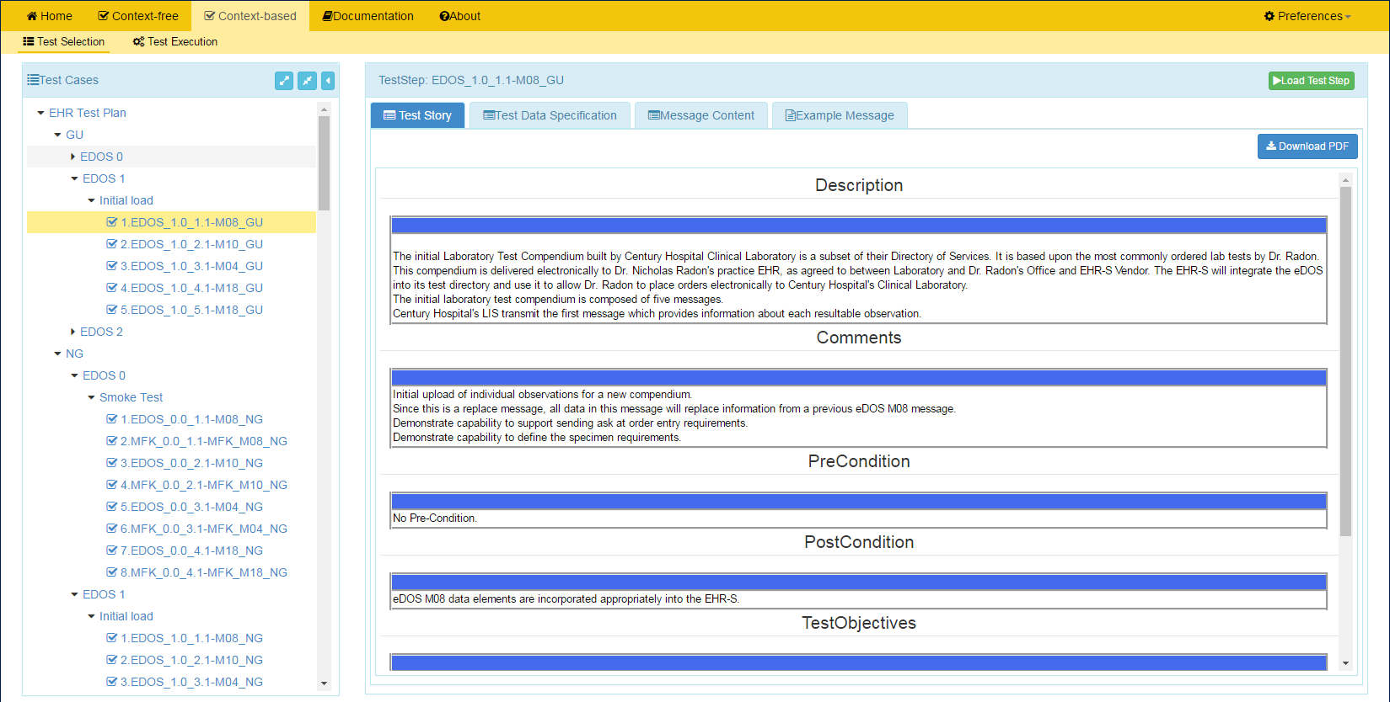
NIST eDOS-EHR Test Tool Screen Shot
1
Open eDOS Validation tool using link:
and click on Context-based
http://hl7v2-edos-r1-testing.nist.gov/edos-r2/#/home
2
Test Selection view of page displays.
3
Click on arrow to open EHR Test Plan.
4
Click on arrows to expand the Test Scenarios and Test Cases. Click on a Test Step.
5
Test Step Title and Test Story tab display.
6
Click on Load Test Step button to proceed with conformance testing for the Test Step.
HIT Context-based Validation
This feature is used to test HIT Modules for conformance to the eDOS standards. The majority of the validation involves inspection testing. This process utilizes an inspector to ascertain if the lab order compendium data provided in the test message are displayed by and incorporated into the Module. The Juror Document (available when the Test Case is selected) guides the inspector through the assessment process. Another type of validation pertains to the automated testing that assesses the Acknowledgements (MFK) sent by the Module to the eDOS Test Harness.

Slide 27
Resources
Test Tool Web Site http://hl7v2-edos-r1-testing.nist.gov/edos-r2/#/home provides
Test Tool (API, Web Application, and Desktop)
Test Cases/Steps, Test Stories, Test Data, Message Content Sheets, Example Messages, Juror Documents
User Documentation
Testing Artifacts
Message Profiles
Value Sets
Validation Reports
Contact
Rob Snelick (rsnelick@nist.gov)

